Slide 1
Classification
Today we will be taking notes on Taxonomy (Classification)

Slide 2
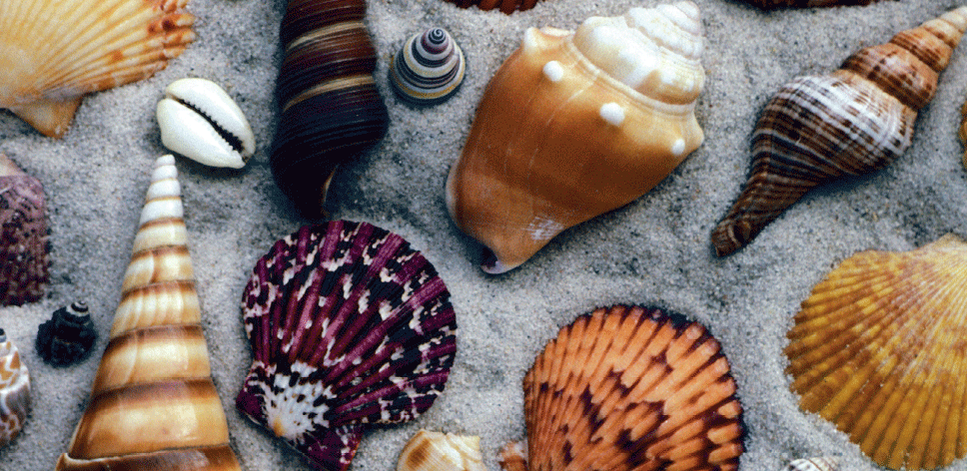
How would you “group” these diverse shells?

Slide 3
Taxonomy
Taxonomy is the discipline where scientists classify organisms and assign each organism a universally accepted name.
Many thinkers and scientists alike have created methods for classifying species based on certain criteria throughout time.

Slide 4
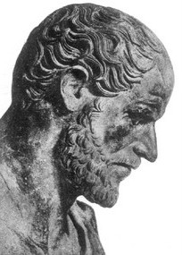
Aristotle
Philosopher in 4th century B.C.
Classified living things into two groups
Animal
Plant
Not based upon evolutionary theory

Slide 5
Carolus Linnaeus
Swedish botanist, 18th century
Developed a hierarchical system of classification consisting of 7 taxa (levels)
Based on structural similarities
Reflects evolutionary history and relationships

Slide 6
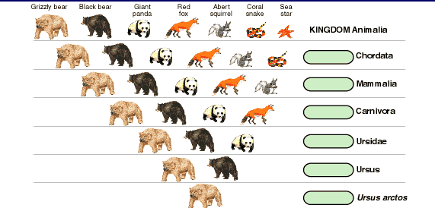
Linnaeus’s System of Classification:
Least
Complex
Kingdom
Phylum
Class
Order
Family
Genus
Species
Most Complex

Slide 7
Kingdom: Largest & most inclusive
EX: Animalia (heterotrophs, multicellular, eukaryotes)

Slide 8
Phylum: Comprised of related classes
EX: Chordata (notochord, nerve cord, pharyngeal pouches, and tail at some point in development)

Slide 9
Class: Comprised of related orders
EX: Mammalia (warm blooded, body hair, nourish young with milk, breathe air, and have 4 chambered hearts)

Slide 10
Order: Comprised of related families
EX: Carnivora (teeth and claws to capture and eat meat)

Slide 11
Family: Comprised of related genera
EX: Ursidae (“doglike” carnivores—includes all bears)

Slide 12
Genus: Comprised of related species
EX: Ursus (brown bears, black bears, and polar bears)

Slide 13
Species: Comprised of individuals that can interbreed; most specific taxon
EX: Arctos (brown bears)

Slide 14
Binomial Nomenclature
Linnaeus created a scientific naming system in which each species has a two-part name (EX: Ursus arctos)
Names are usually derived from Latin or Greek!
The 1st name (Ursus) is the genus and the 2nd name (arctos) is the species. The name is always italicized and only the first name is capitalized.
Names can be abbreviated by using the first letter of the genus and entire species name. (EX: U. arctos)

Slide 15
2 Kingdoms
Linnaeus only identified 2 Kingdoms:
Plantae-green, photosynthetic organisms that used energy from the sun
Animalia: mobile organisms that used food for energy

Slide 16
The Tree of Life Evolves
As biologists learned more about the natural world, they realized just 2 Kingdoms did not accurately describe the diversity of life

Slide 17
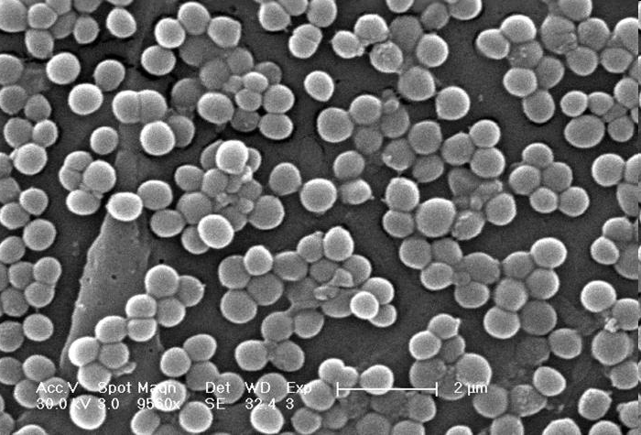
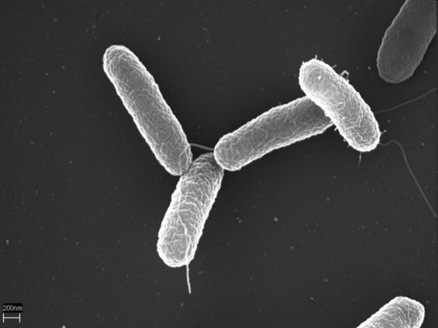
Eubacteria
Salmonella
Prokaryotic
Unicellular
Auto- & hetero-trophic
Have cell walls with peptidoglycan
Live almost everywhere
Staphylococcus, Streptococcus, E. coli
MRSA

Slide 18
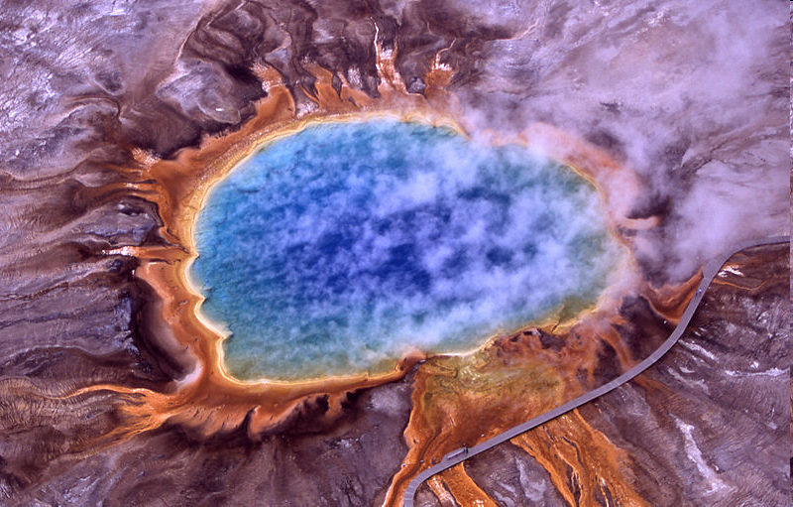
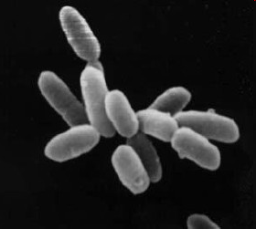
Archaebacteria
Prokaryotic
Unicellular
Auto- & hetero-trophic
Cell wall without peptidoglycan
Live in extreme (temp, pH, salt)environments
Ex: methanogens, halophiles
Yellowstone Hot Springs
Halobacteria

Slide 19
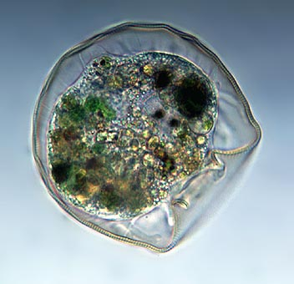
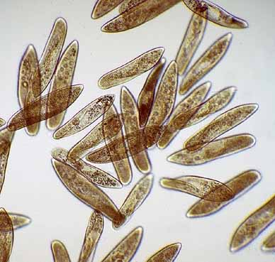
Protists
Eukaryotic
Uni- & multi-cellular
Auto- & hetero-trophic
Lack complex organ
systems
Live in moist environments
Algae, slime molds, protozoa

Slide 20
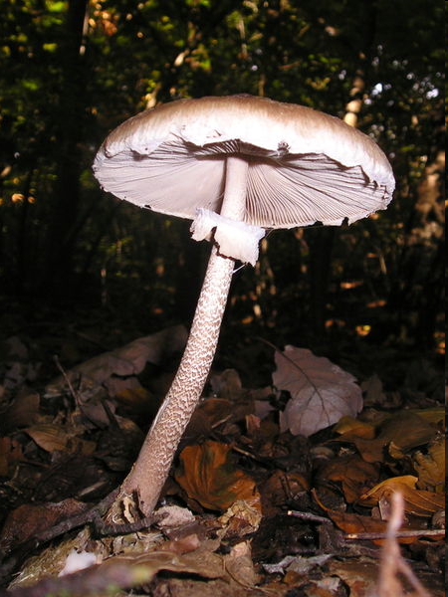
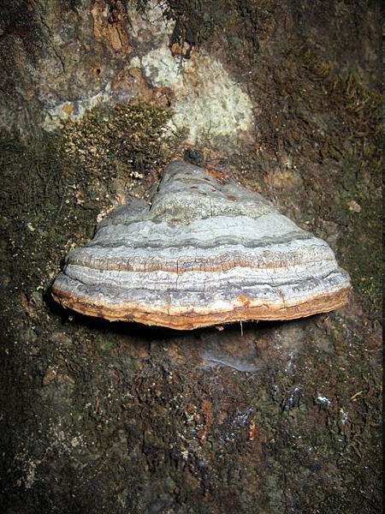
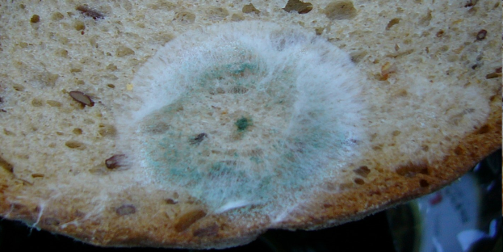
Fungi
Eukaryotic
Mostly multi-
cellular
Heterotrophic
(decomposers-Absorb nutrients from organic material by secreting digestive enzymes)
Cell walls made of chitin
Mushrooms, bread mold, yeast

Slide 21
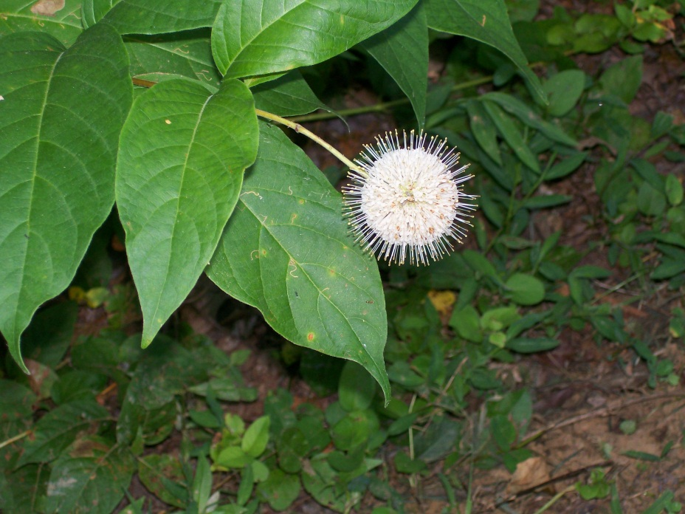
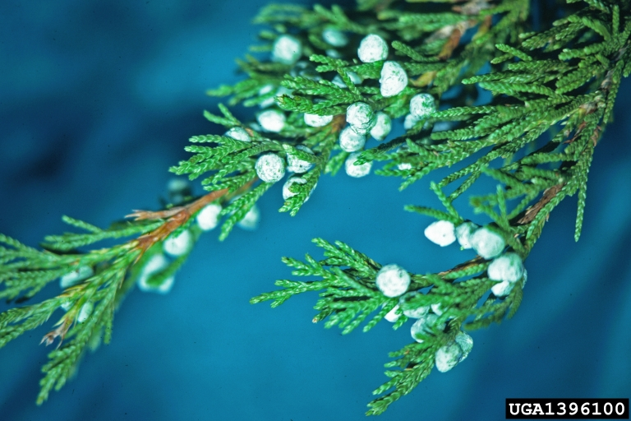
Plants
Eukaryotic
Multicellular
Autotrophic
(Photosynthetic)
Cell walls made of cellulose
Have organ systems
Flowering plants, moss, ferns, conifers
Buttonbush
Eastern Red Cedar

Slide 22
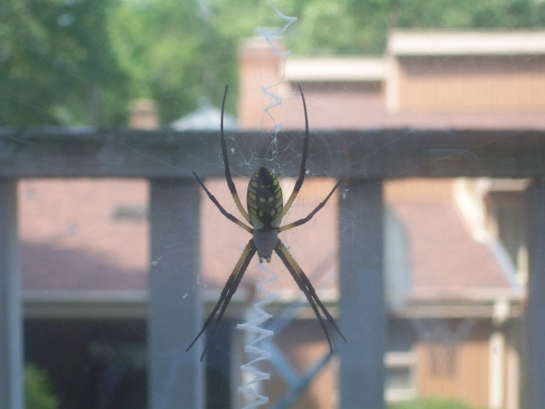
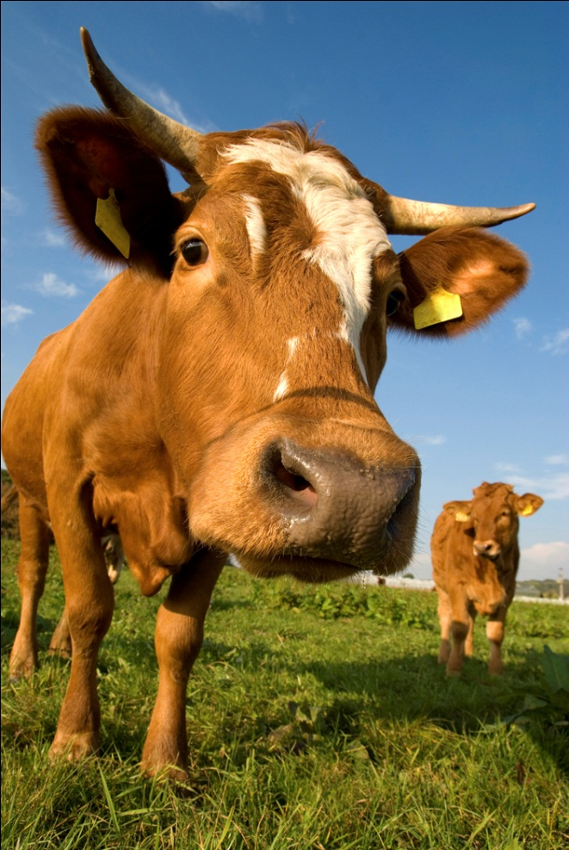
Animals
Eukaryotic
Multicellular
Heterotrophic
Do not have cell walls
Sponges, worms, insects, reptiles, fish, amphibians, birds, mammals

Slide 23
Order Amongst Diversity
Scientists have identified and named 1.5 million species so far
They estimate there are between 2 to 100 million additional species that have yet to be discovered!

Slide 24
Domains
An even more general classification taxa than kingdoms
Proposed by Carl Woese, 1990s
Three domains:
Bacteria (include Eubacteria)
Archaea (includes Archaebacteria)
Eukarya (includes plants, animals, fungi, protists)

Slide 25
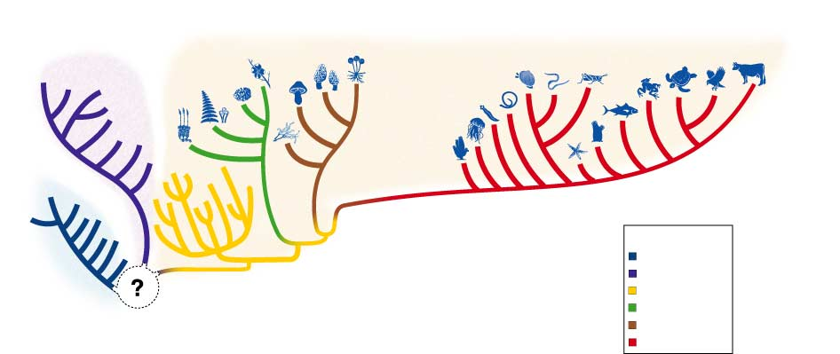
DOMAIN ARCHAEA
DOMAIN EUKARYA
Eubacteria
Archaebacteria
Protista
Plantae
Fungi
Animalia
DOMAIN BACTERIA

Slide 26
Key Characteristics of Domains and Kingdoms
Section 18-3
Classification of Living Things
DOMAIN
KINGDOM
CELL TYPE
CELL STRUCTURES
NUMBER OF CELLS
MODE OF NUTRITION
EXAMPLES
Bacteria
Eubacteria
Prokaryote
Cell walls with peptidoglycan
Unicellular
Autotroph or heterotroph
Streptococcus, Escherichia coli
Archaea
Archaebacteria
Prokaryote
Cell walls without peptidoglycan
Unicellular
Autotroph or heterotroph
Methanogens, halophiles
Protista
Eukaryote
Cell walls of cellulose in some; some have chloroplasts
Most unicellular; some colonial; some multicellular
Autotroph or heterotroph
Amoeba, Paramecium, slime molds, giant kelp
Fungi
Eukaryote
Cell walls of chitin
Most multicellular; some unicellular
Heterotroph
Mushrooms, yeasts
Eukarya
Plantae
Eukaryote
Cell walls of cellulose; chloroplasts
Multicellular
Autotroph
Mosses, ferns, flowering plants
Animalia
Eukaryote
No cell walls or chloroplasts
Multicellular
Heterotroph
Sponges, worms, insects, fishes, mammals

Slide 27
Invertebrates
Over 95% of all animal species are invertebrates, or organisms that do NOT have a backbone (vertebral column)
Let’s look at a cladogram of invertebrate animals...

Slide 28
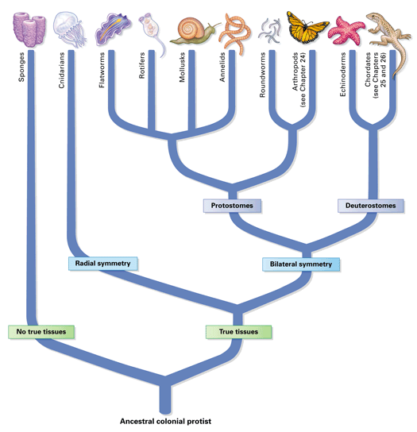
Complex
Simple

Slide 29
Vertebrates
The other 5% of animals are vertebrates. Most “animals” we think of (fishes, amphibians, reptiles, birds, and mammals) are in this 5% minority!
Let’s look at a cladogram of vertebrate animals...

Slide 30
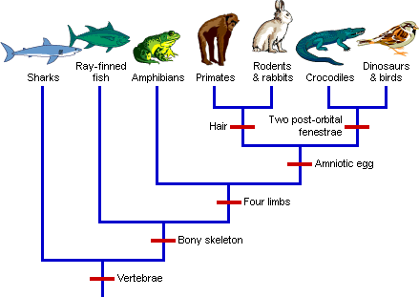
mammals
Reptiles & aves
amniotes
tetrapods
True skeletons
vertebrates

Slide 31
Trends in Animal Evolution
Complex animals tend to have...
cell specialization
internal body organization
bilateral body symmetry
a front end or head with sense organs
and a body cavity.

